Slide 1
Operating Systems
Chapter 5b
Process Scheduling
Hammad Afzal
hammad.afzal@mcs.edu.pk
Department of Computer Software Engineering
National University of Sciences and Technology

Slide 2
First-Come, First-Served (FCFS) Scheduling
Process Burst Time
P₁ 24
P₂ 3
P₃ 3
Suppose that the processes arrive in the order: P₁ , P₂ , P₃ The Gantt Chart for the schedule is:
Waiting time for P₁ = 0; P₂ = 24; P₃ = 27
Average waiting time: (0 + 24 + 27)/3 = 17
P₁
P₂
P₃
0
24
27
30

Slide 3
FCFS Scheduling (Cont.)
Suppose that the processes arrive in the order:
P₂ , P₃ , P₁
The Gantt chart for the schedule is:
Waiting time for P₁ = 6; P₂ = 0; P₃ = 3
Average waiting time: (6 + 0 + 3)/3 = 3
Much better than previous case
Convoy effect - short process behind long process
Consider one CPU-bound and many I/O-bound processes
FCFS is non-preemptive
P₂
P₃
P₁
0
3
6
30

Slide 4
Shortest-Job-First (SJF) Scheduling
Associate with each process the length of its next CPU burst
Use these lengths to schedule the process with the shortest time.
This algorithm may also be called as shortest-next-CPU-burst algorithm

Slide 5
Example of SJF
ProcessArriva l Time Burst Time
P₁ 0.0 6
P₂ 2.0 8
P₃ 4.0 7
P₄ 5.0 3
SJF scheduling chart
Average waiting time = (3 + 16 + 9 + 0) / 4 = 7
P₄
P₁
P₃
P₂
0
3
9
16
24

Slide 6
Shortest-Job-First (SJF) Scheduling
SJF is optimal – gives minimum average waiting time for a given set of processes
The difficulty is knowing the length of the next CPU request
Could ask the user in batch systems. SJF is more popular for batch systems and long term scheduling.
Can not be easily implemented at level of Short Term Scheduling.
One solution is to predict the next CPU burst time on the basis of previous history of the process.

Slide 7
Example of Shortest-remaining-time-first
SJF can be preemptive and non-preemptive.
Lets add the concepts of varying arrival times and preemption to the analysis
ProcessA arri Arrival TimeT Burst Time
P₁ 0 8
P₂ 1 4
P₃ 2 9
P₄ 3 5
Preemptive SJF Gantt Chart
Average waiting time = [(10-1)+(1-1)+(17-2)+5-3)]/4 = 26/4 = 6.5 msec
P₁
P₂
P₄
P₁
P₃
0
1
5
10
17
26

Slide 8
Priority Scheduling
A priority number (integer) is associated with each process
The CPU is allocated to the process with the highest priority (smallest integer ≡ highest priority)
Equal Priority processes are scheduled in FCFS order.
SJF is priority scheduling where priority is the inverse of predicted next CPU burst time

Slide 9
Example of Priority Scheduling
ProcessA arri Burst TimeT Priority
P₁ 10 3
P₂ 1 1
P₃ 2 4
P₄ 1 5
P₅ 5 2
Priority scheduling Gantt Chart
Average waiting time = 8.2 msec
P₂
P₅
P₁
P₃
P₄
0
1
6
16
18
19

Slide 10
Priority Scheduling
Internal and External Priorities
Internal
Features internal to OS determine this priority.
Examples: time limits, memory requirements, nunmber of open files, ratio of avg I/O burst to CPU burst etc.
External
Features external to OS determine this priority.
Examples: importance of the process, the type and amount of funds being paid for computer use etc.
Priority scheduling can be
Preemptive
Non-preemptive
A very interesting example in Book

Slide 11
Priority Scheduling: Starvation
Problem:
Lower-priority may suffer starvation if there is a steady supply of high priority processes.
Solution
Aging: Allow a process to change its priority based on its age or execution history
Notes:
One problem with a pure priority scheduling scheme is that lower-priority processes may suffer starvation.
This will happen if there is always a steady supply of higher-priority ready processes.
If this behaviour is not desirable, the priority of a process can change with its age or execution history.

Slide 12
Round Robin (RR)
Designed specially for time-sharing systems.
A small unit of time called time quantum or time slice is used.
Timer interrupts every quantum to schedule next process
Each process gets a small unit of CPU time (time quantum q), usually 10-100 milliseconds. After this time has elapsed, the process is preempted and added to the end of the ready queue.
The ready queue is circular queue
Is it preemptive or non-preemptive?
Similar to FCFS, but preemption is added.

Slide 13
Round Robin
Clock interrupt is generated at periodic intervals
When an interrupt occurs, the currently running process is placed in the ready queue
Next ready job is selected
Notes:
A clock interrupt is generated at periodic intervals.
When the interrupt occurs, the currently running process is placed in the ready queue, and the next ready job is selected on a FCFS basis.

Slide 14
Round Robin (RR)
If there are n processes in the ready queue and the time quantum is q, then each process gets 1/n of the CPU time in chunks of at most q time units at once. No process waits more than (n-1)q time units.
Performance depends heavily on Quantum
q large ⇒ FIFO
q small ⇒ q must be large with respect to context switch, otherwise overhead is too high
With q small, it becomes processor sharing.
What is the context of this name?

Slide 15
Example of RR with Time Quantum = 4
Process Burst Time
P₁ 24
P₂ 3
P₃ 3
The Gantt chart is:
Typically, higher average turnaround than SJF, but better response
q should be large compared to context switch time
q usually 10ms to 100ms, context switch < 10 usec
P₁
P₂
P₃
P₁
P₁
P₁
P₁
P₁
0
4
7
10
14
18
22
26
30

Slide 16
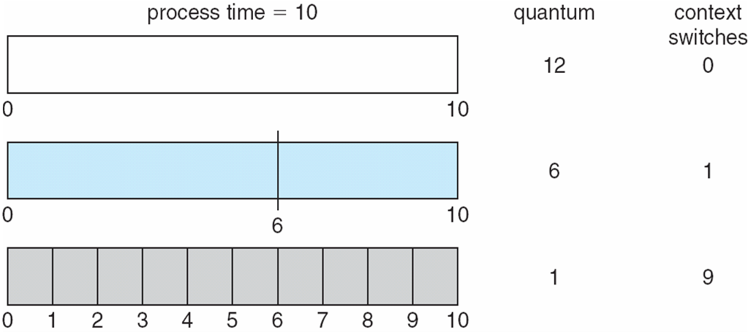
Time Quantum and Context Switch Time

Slide 17
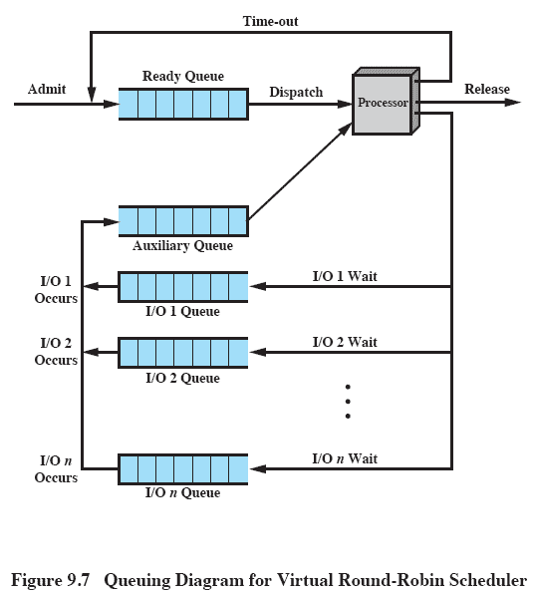
‘Virtual Round Robin’
Notes:
As per usual:
New processes arrive and join the ready queue, which is managed on an FCFS basis.
When a running process times out, it is returned to the ready queue.
When a process is blocked for I/O, it joins an I/O queue.
The new feature is an FCFS auxiliary queue to which processes are moved after being released from an I/O block.
When a dispatching decision is to be made, processes in the auxiliary queue get preference over those in the main ready queue.
When a process is dispatched from the auxiliary queue, it runs no longer than a time equal to the basic time quantum minus the total time spent running since it was last selected from the main ready queue.
Performance studies indicate that this approach is indeed superior to round robin in terms of fairness.

Slide 18
Multilevel Queue
Processes can be classified into different groups
foreground (interactive)
background (batch)
Different response times, different scheduling needs
Ready queue is partitioned into separate queues.
Process permanently in a given queue.
Processor assigned based on some property. E.g. memory size, process priority.
Each queue has its own scheduling algorithm:
foreground – RR
background – FCFS

Slide 19
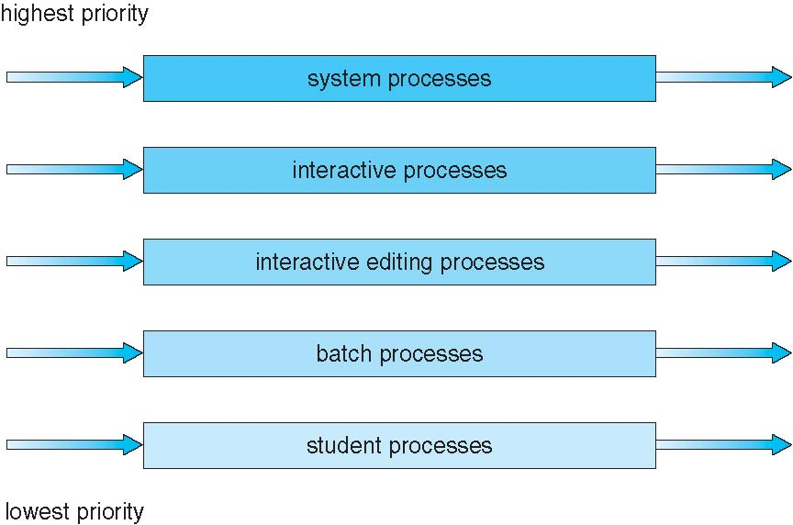
Multilevel Queue
Scheduling must be done between the queues:
Fixed priority scheduling; (i.e., serve all from foreground then from background).
Problem: Possibility of starvation.
Solution:
Time slice – each queue gets a certain amount of CPU time which it can schedule amongst its processes; i.e., 80% to foreground in RR
20% to background in FCFS

Slide 20
Multilevel Feedback Queue
A process can move between the various queues;
E.g. Separate processes according to characteristics of CPU bursts.
If process uses too much CPU time, move it to low priority queue.
I/O bound and interactive will have high priority.
Aging can be implemented this way

Slide 21
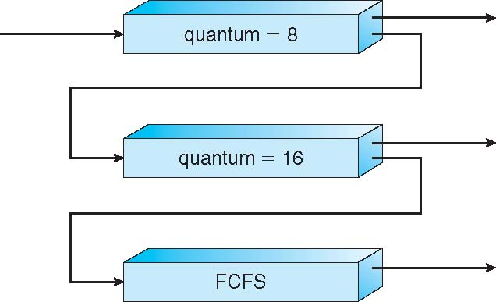
Example of Multilevel Feedback Queue
Three queues:
Q₀ – RR with time quantum 8 milliseconds
Q₁ – RR with time quantum 16 milliseconds
Q₂ – FCFS

Slide 22
Example of Multilevel Feedback Queue
Scheduling
A new job enters queue Q₀ which is served FCFS
When it gains CPU, job receives 8 milliseconds
If it does not finish in 8 milliseconds, job is moved to queue Q₁
At Q₁ job is again served FCFS and receives 16 additional milliseconds
If it still does not complete, it is preempted and moved to queue Q₂

Slide 23
Multilevel Feedback Queue
Multilevel-feedback-queue scheduler defined by the following parameters:
number of queues
scheduling algorithms for each queue
method used to determine when to upgrade a process
method used to determine when to demote a process
method used to determine which queue a process will enter when that process needs service
Most general CPU scheduling algorithm but is complex.

